Slide 1
https://www.edureka.co/blog/interview-questions/python-interview-questions/

Slide 2
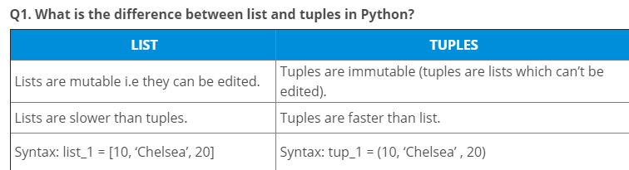

Slide 3
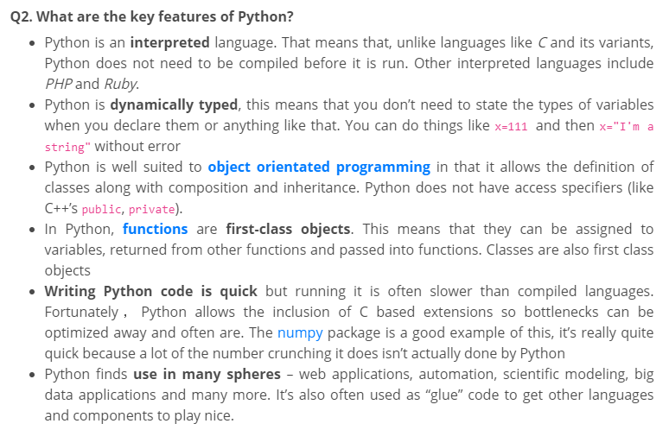

Slide 4
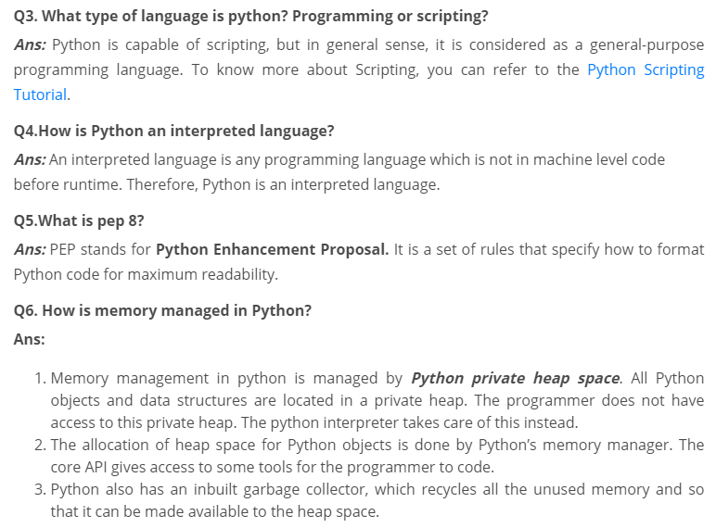

Slide 5
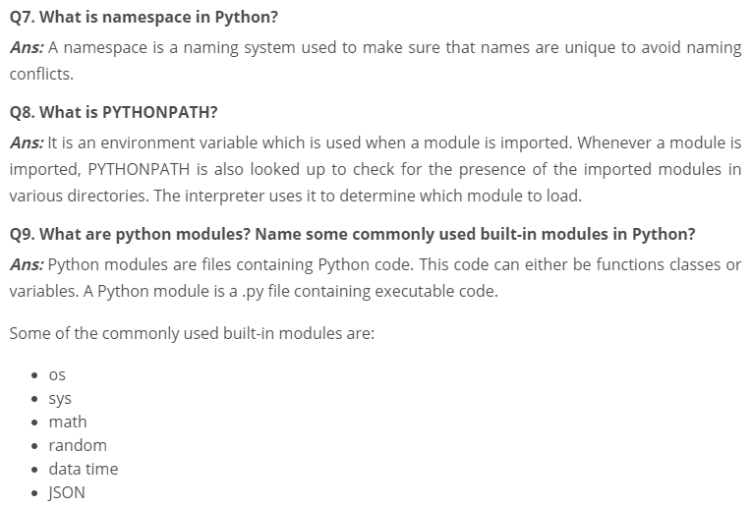

Slide 6
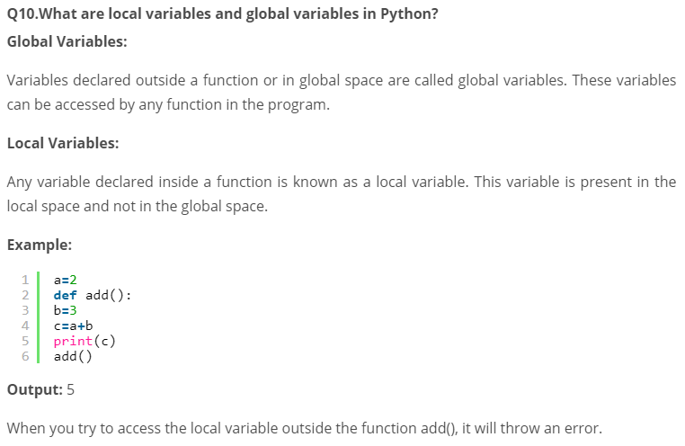

Slide 7
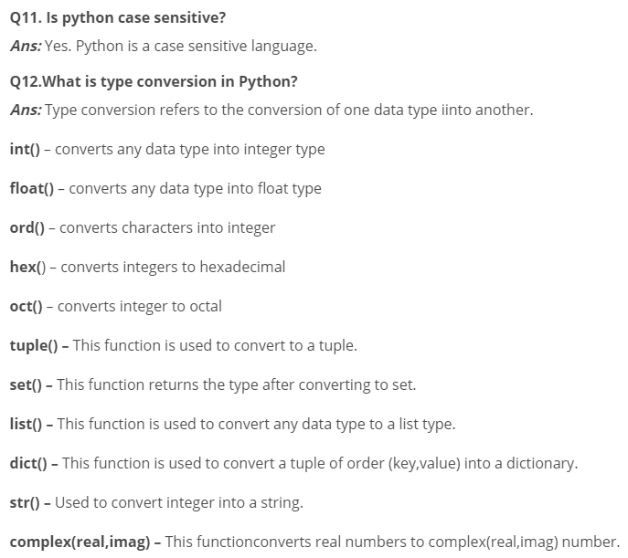

Slide 8
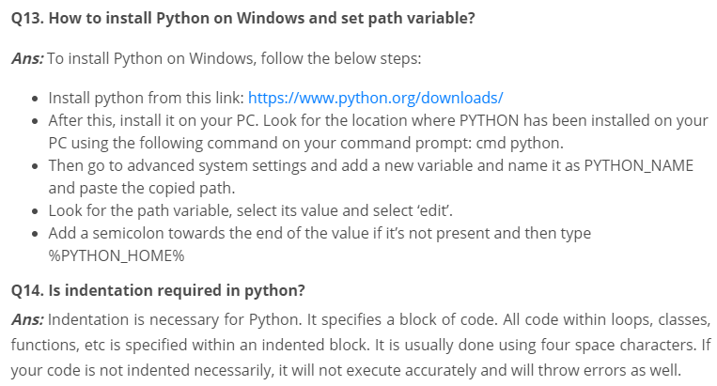

Slide 9
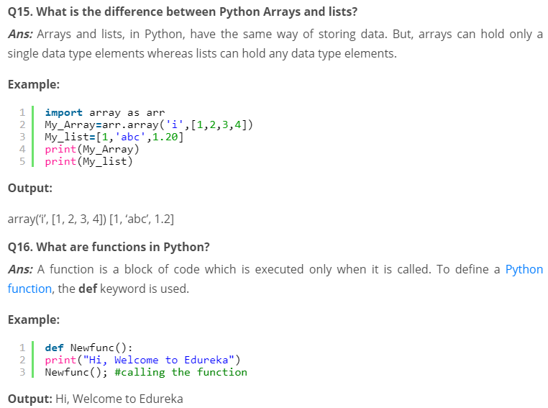

Slide 10
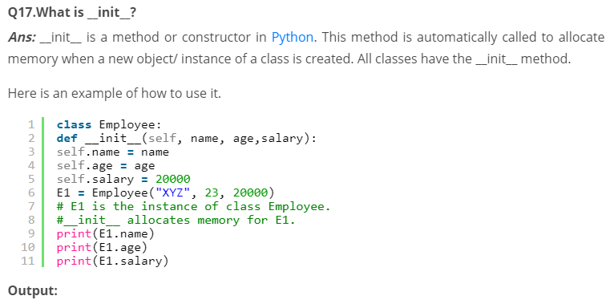


Slide 11
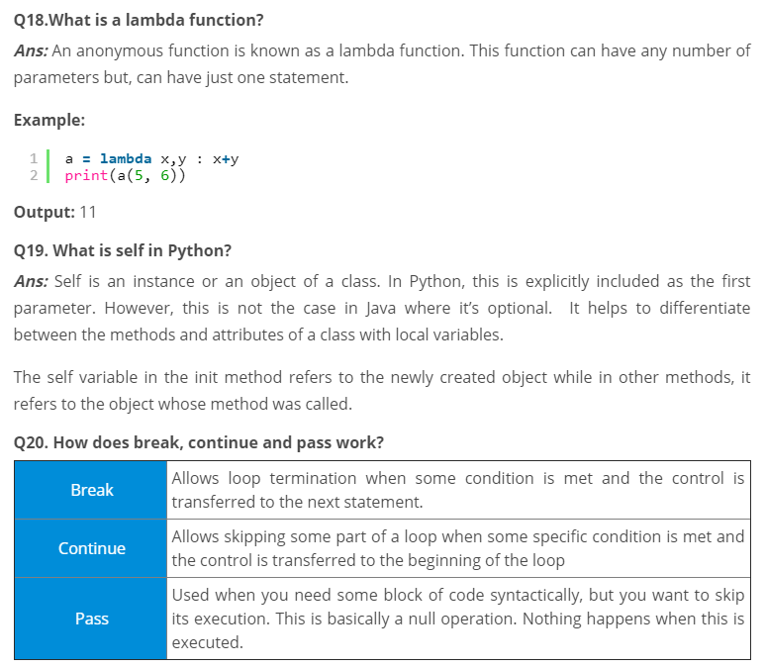

Slide 12
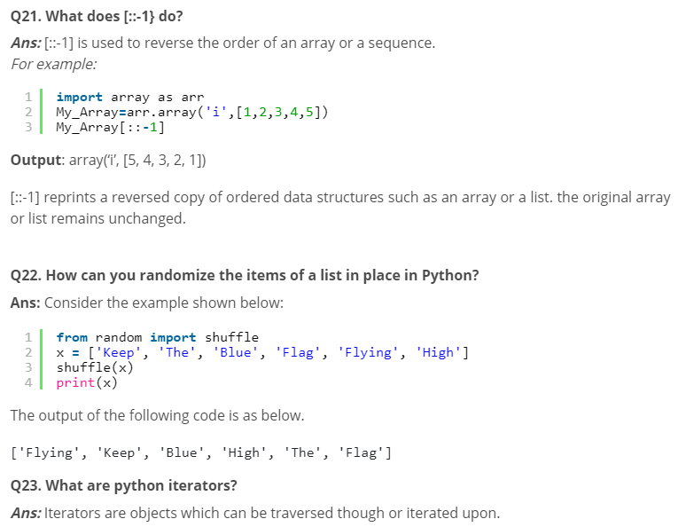

Slide 13
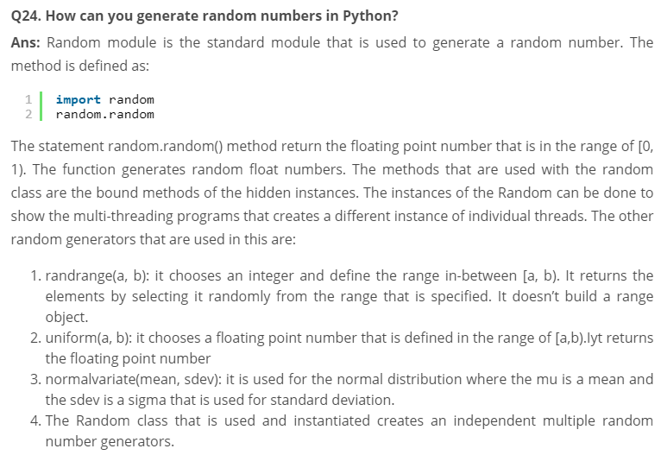

Slide 14
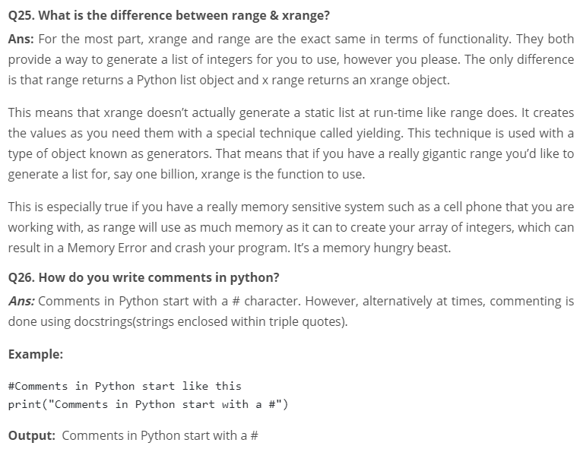

Slide 15
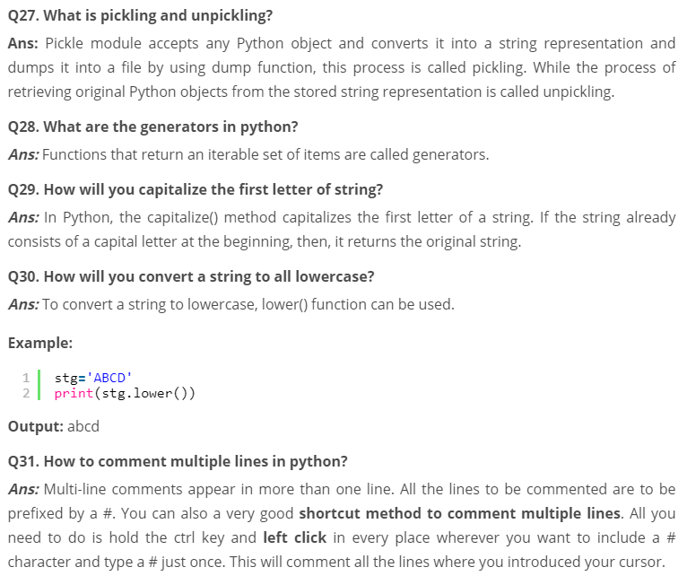

Slide 16
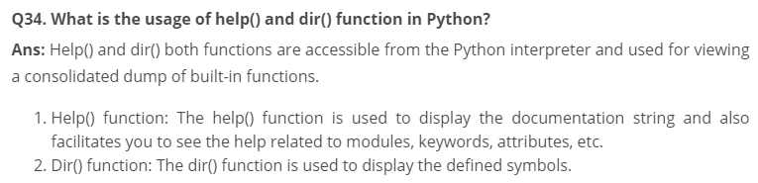
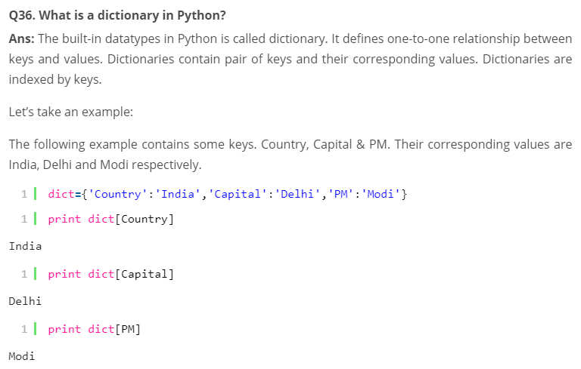

Slide 17
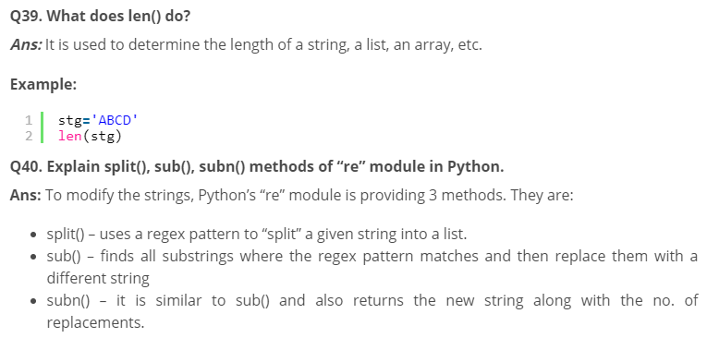

Slide 18
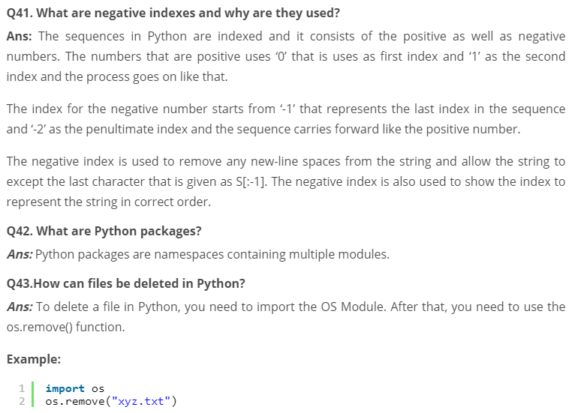

Slide 19
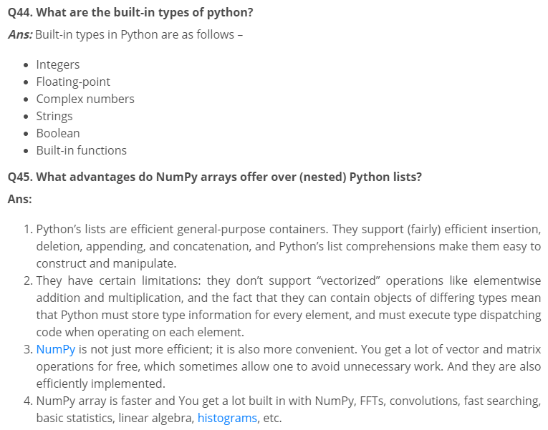

Slide 20
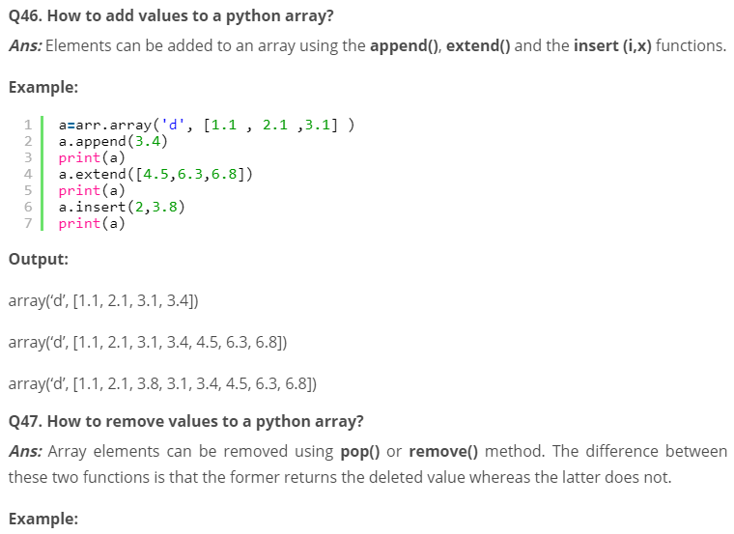
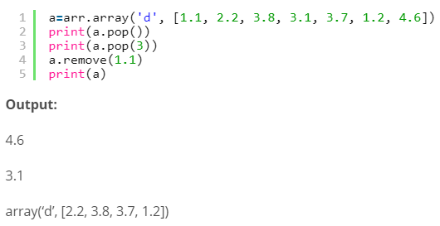

Slide 21
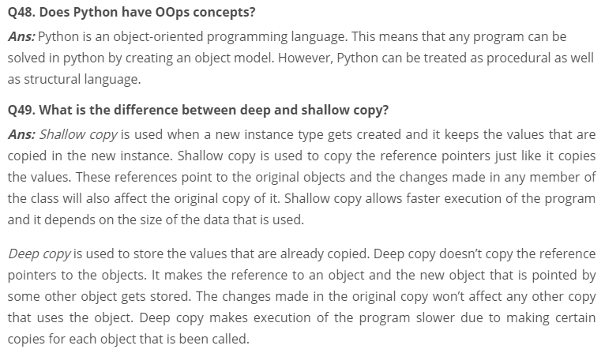

Slide 22
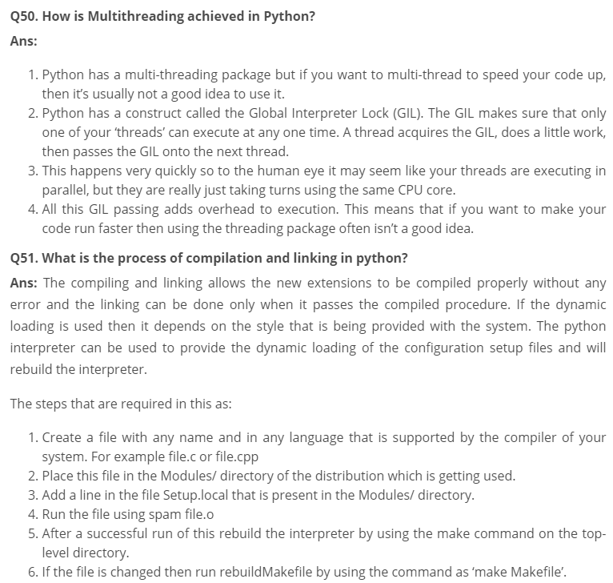

Slide 24
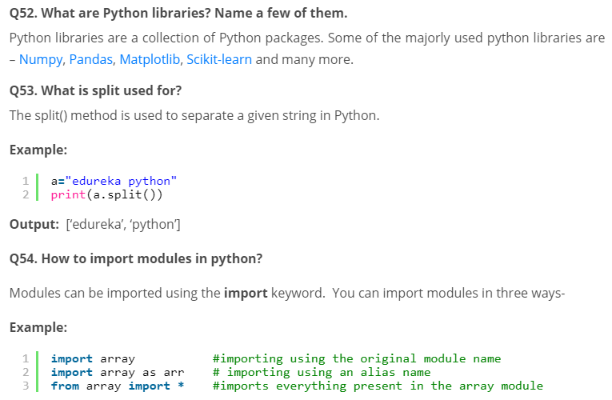

Slide 25
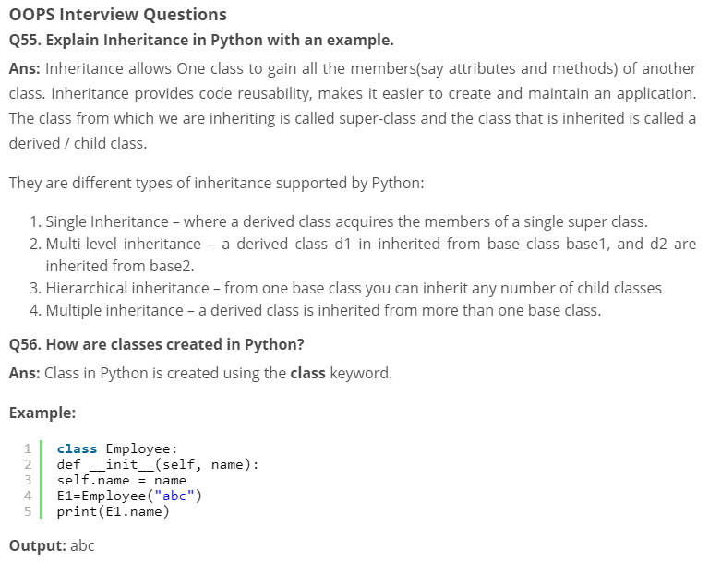

Slide 26
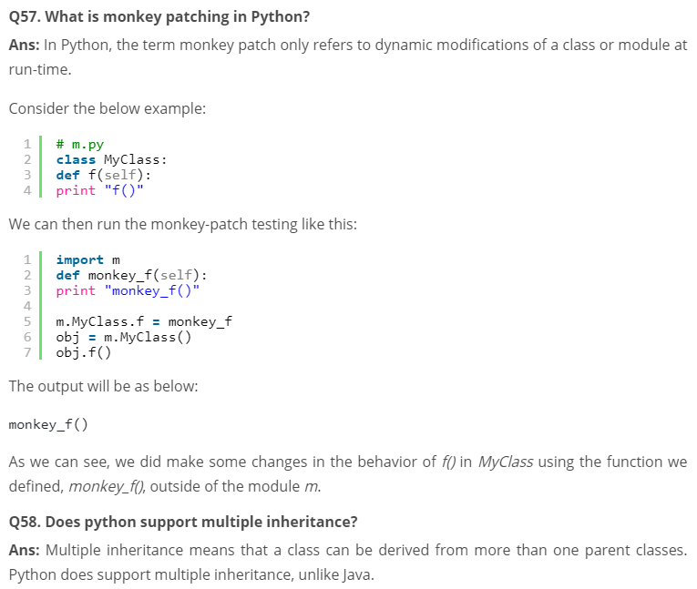

Slide 27
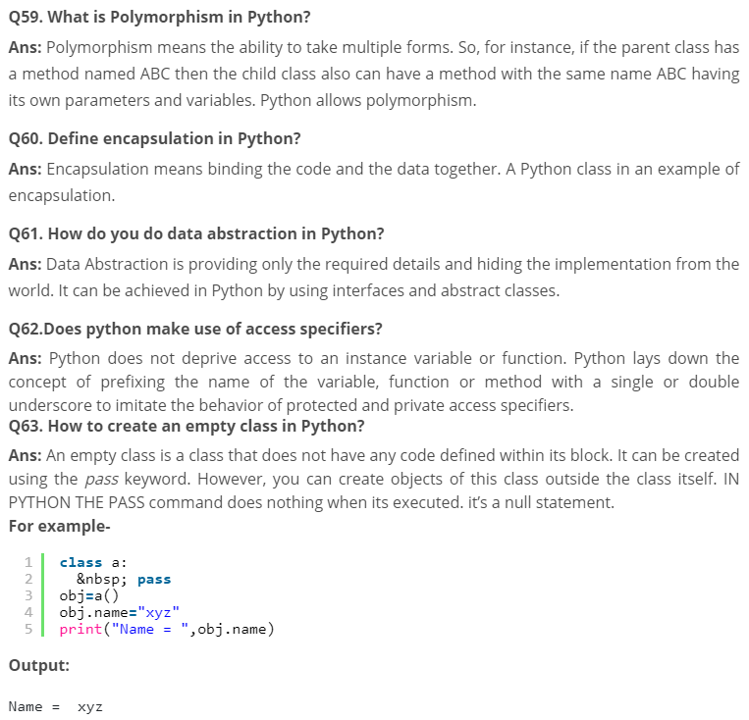

Slide 28
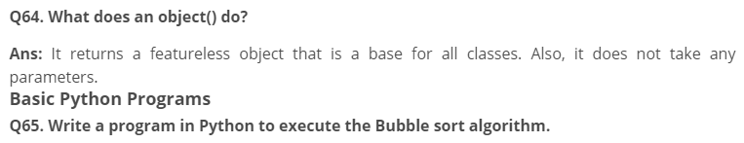

def bs(a):&nbsp; &nbsp; &nbsp; &nbsp; &nbsp; &nbsp; &nbsp;# a = name of list
&nbsp; b=len(a)-1&nbsp; &nbsp; &nbsp; &nbsp; &nbsp;# minus 1 because we always compare 2 adjacent values
&nbsp; &nbsp; &nbsp; &nbsp; &nbsp; &nbsp; &nbsp; &nbsp; &nbsp; &nbsp; &nbsp; &nbsp; &nbsp; &nbsp;
&nbsp; for x in range(b):
&nbsp; &nbsp; &nbsp; for y in range(b-x):
&nbsp; &nbsp; &nbsp; &nbsp; &nbsp; if a[y]>a[y+1]:
&nbsp; &nbsp; &nbsp; &nbsp; &nbsp; &nbsp; &nbsp; a[y],a[y+1]=a[y+1],a[y]
&nbsp; return a
a=[32,5,3,6,7,54,87]
bs(a)

Slide 29
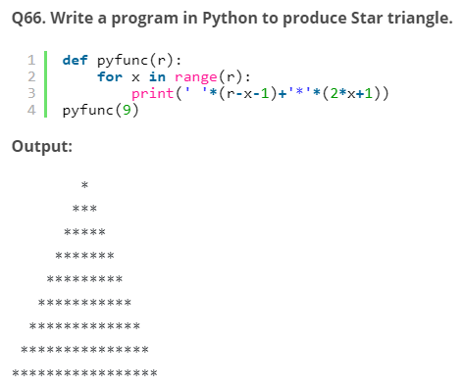

Slide 30
Q67. Write a program to produce Fibonacci series in Python.
# Enter number of terms needed&nbsp; &nbsp; &nbsp; &nbsp; &nbsp; &nbsp; &nbsp; &nbsp; &nbsp; &nbsp;#0,1,1,2,3,5....
a=int(input("Enter the terms"))
f=0&nbsp; &nbsp; &nbsp; &nbsp; &nbsp; &nbsp; &nbsp; &nbsp; &nbsp; &nbsp; &nbsp; &nbsp; &nbsp; &nbsp; &nbsp; &nbsp; &nbsp; &nbsp; &nbsp; &nbsp; &nbsp;#first element of series
s=1&nbsp; &nbsp; &nbsp; &nbsp; &nbsp; &nbsp; &nbsp; &nbsp; &nbsp; &nbsp; &nbsp; &nbsp; &nbsp; &nbsp; &nbsp; &nbsp; &nbsp; &nbsp; &nbsp; &nbsp; &nbsp;#second element of series
if a<=0:
&nbsp; print("The requested series is
",f)
else:
&nbsp; print(f,s,end=" ")
&nbsp; for x in range(2,a):
&nbsp; &nbsp; &nbsp; next=f+s&nbsp; &nbsp; &nbsp; &nbsp; &nbsp; &nbsp; &nbsp; &nbsp; &nbsp; &nbsp; &nbsp; &nbsp; &nbsp;
&nbsp; &nbsp; &nbsp; print(next,end=" ")
&nbsp; &nbsp; &nbsp; f=s
&nbsp; &nbsp; &nbsp; s=next</pre>
Output: Enter the terms 5 0 1 1 2 3

Slide 31
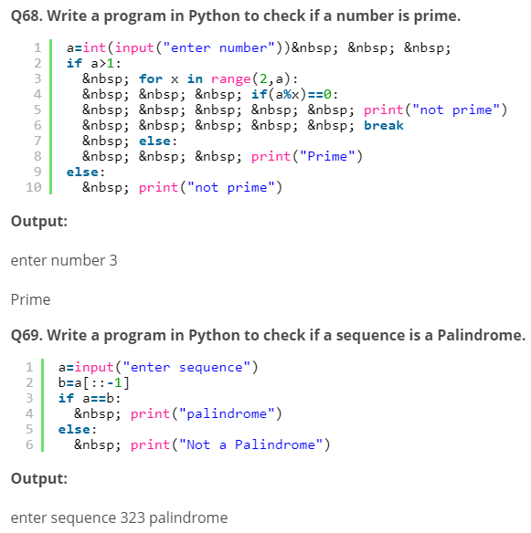

Slide 32
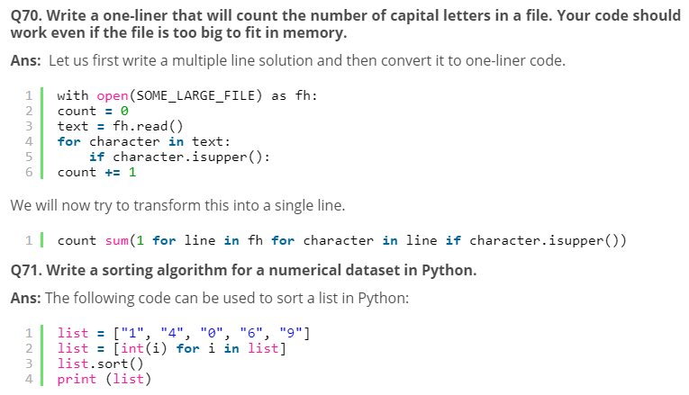

Slide 33
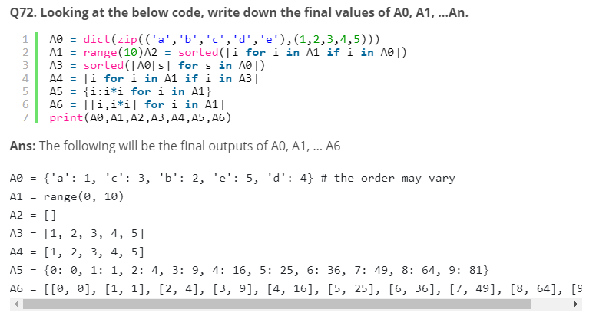

Slide 34
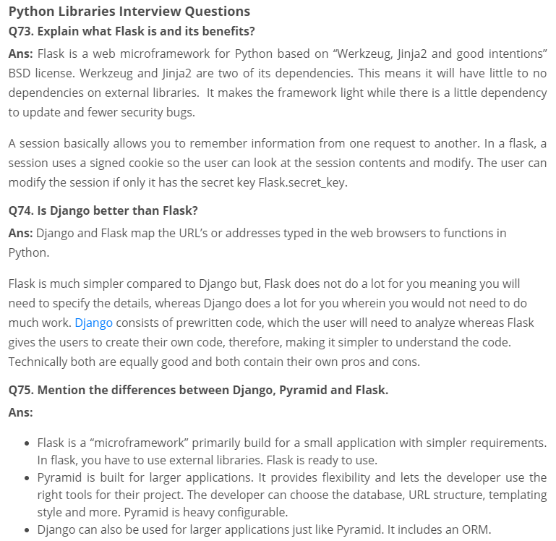

Slide 35
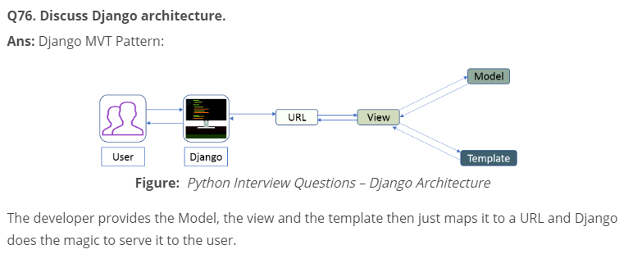

Slide 36
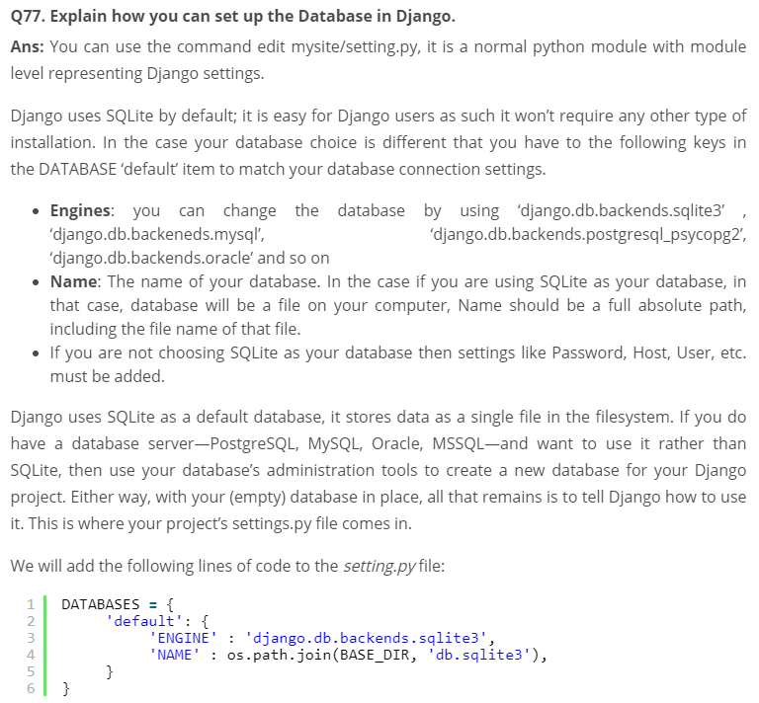

Slide 37
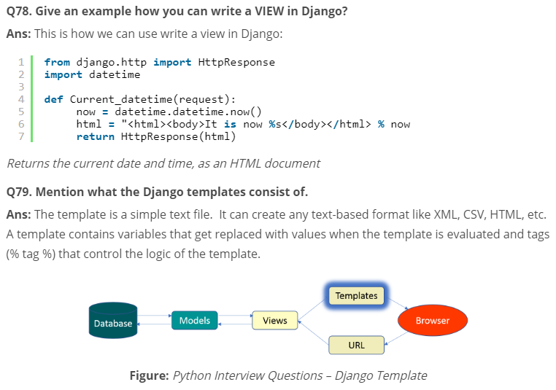

Slide 38
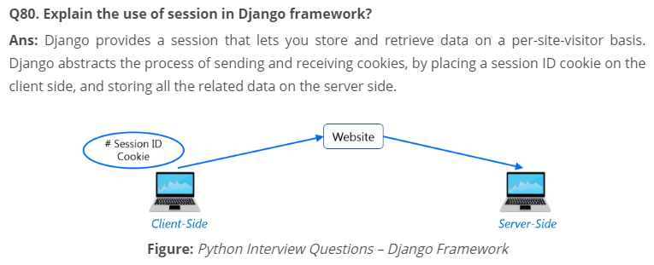
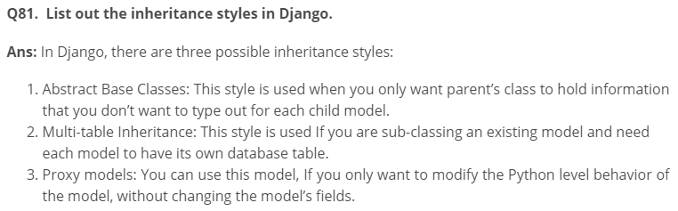
So the data itself is not stored client side. This is nice from a security perspective.

Slide 39
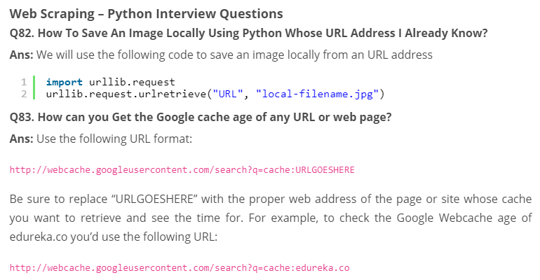

Slide 40
Q84. You are required to scrap data from IMDb top 250 movies page. It should only have fields movie name, year, and rating.
Ans: We will use the following lines of code:
from bs4 import BeautifulSoup
import requests
import sys
url = 'http://www.imdb.com/chart/top'
response = requests.get(url)
soup = BeautifulSoup(response.text)
tr = soup.findChildren("tr")
tr = iter(tr)
next(tr)
for movie in tr:
title = movie.find('td', {'class': 'titleColumn'} ).find('a').contents[0]
year = movie.find('td', {'class': 'titleColumn'} ).find('span', {'class': 'secondaryInfo'}).contents[0]
rating = movie.find('td', {'class': 'ratingColumn imdbRating'} ).find('strong').contents[0]
row = title + ' - ' + year + ' ' + ' ' + rating
print(row)
The above code will help scrap data from IMDb’s top 250 list

Slide 41
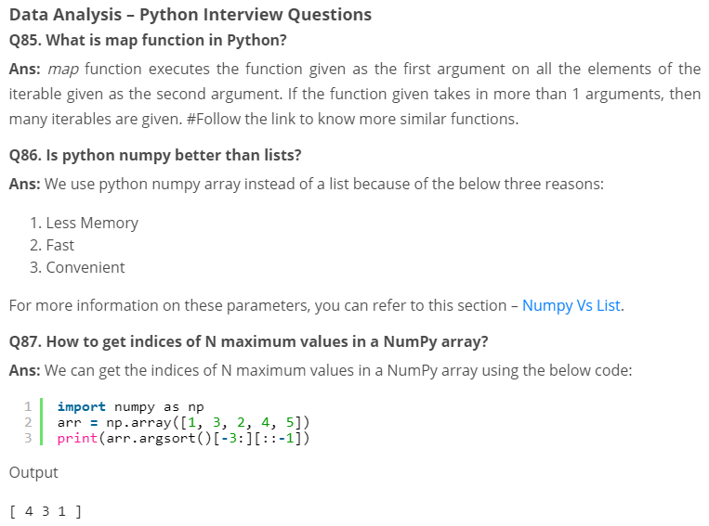

Slide 42
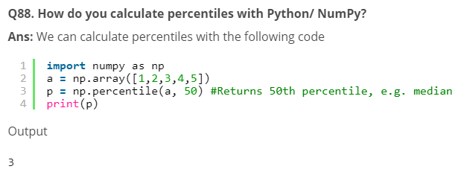

Slide 43
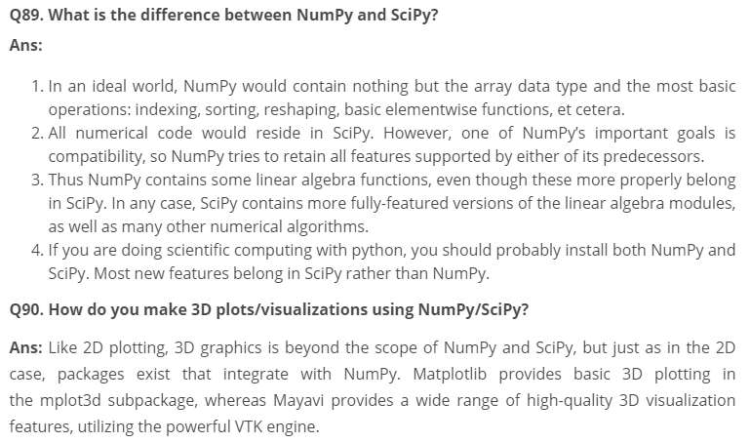

Slide 44
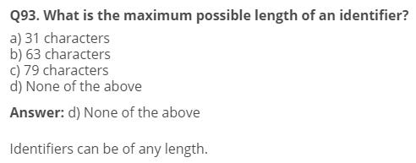
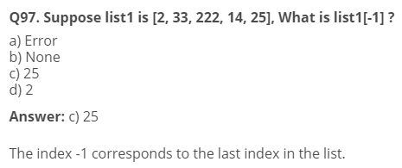

Slide 45
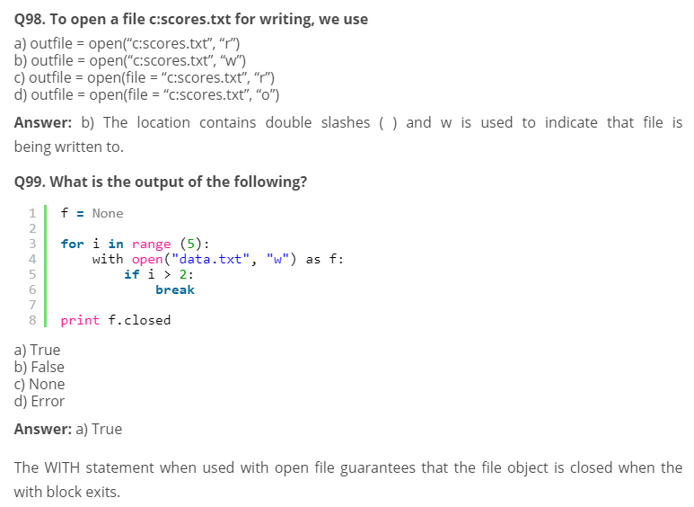

Slide 46
